Slide 1
NIDEC CORPORATION
NPMS (NCVP Production Management System) Overview
Dept: Production Engineering Center
Date: 20thJan 2018

Slide 2
NCVP Production Management System (NPMS)
Purpose: Improve yield of base plate production process (quality improvement).
Standard equipment management and document management.
Follow up online machines working status
The main function of the system:
Drawing maintenance: Record the saving location of drawing and easy to access or open the drawing
Document management: Record the saving location of document and easy to access or open the document. In future, we will combine it with ISO system to create ISO electronics (online) without using papers.
Machine working status: Follow up the status of machines on production line by user. In future, it will be used in monitor room to view online the machines status
Account Equipment Management: Control the position, status, life, depreciation,... of equipment in ware house or production line

Slide 3
NCVP Production Management System (NPMS)
Function Introduction
Ⅰ. Master Menu
Ⅱ. NPMS Application Menu
1. System Masters
1. Technical Maintenance
2. Local Masters
2.1. Master
2.2. Account-WH
2.3. Working Status
2.4. Jig - Draw
2. Control Management
3. Warehouse - Equipment

Slide 4
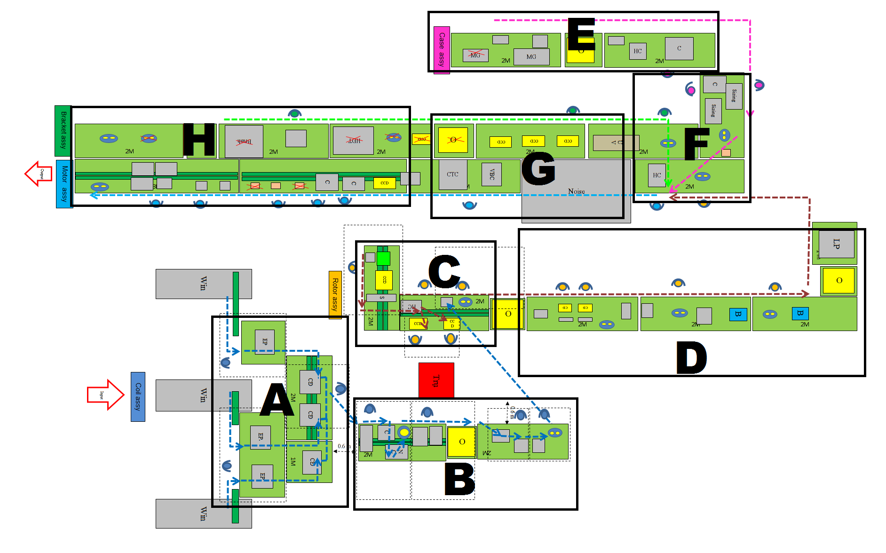

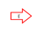
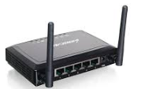

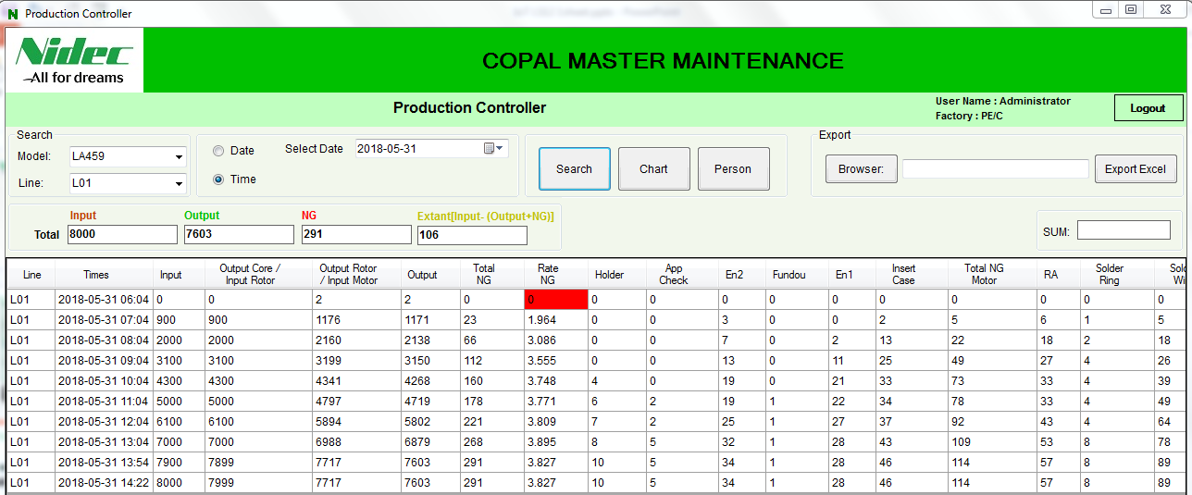




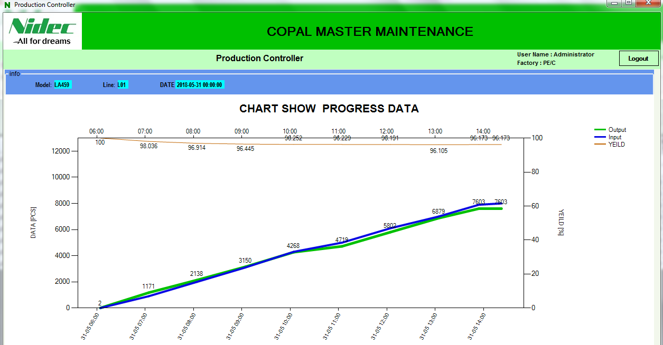
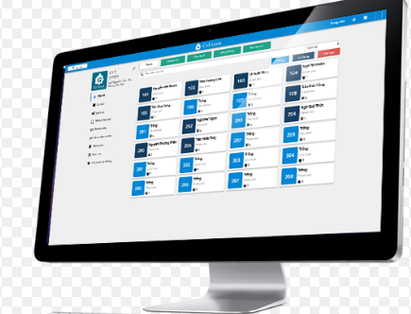
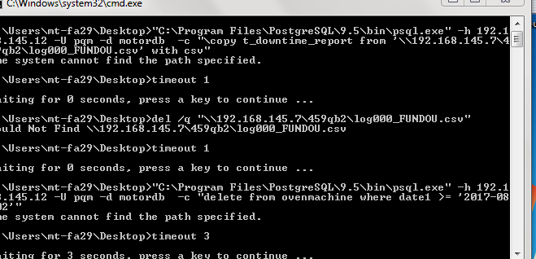
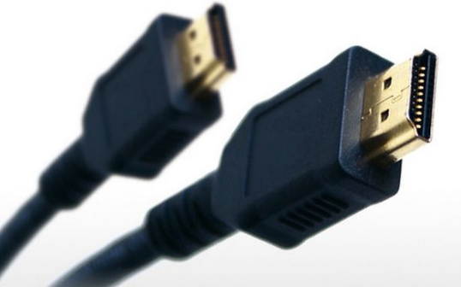
4．FY17 活動計画IOT事例
有線
LS12
Board wifi
NG BOX
無線
無線
MES
Managers
Customer
Sub soft
モニタ
HDMI

Slide 5
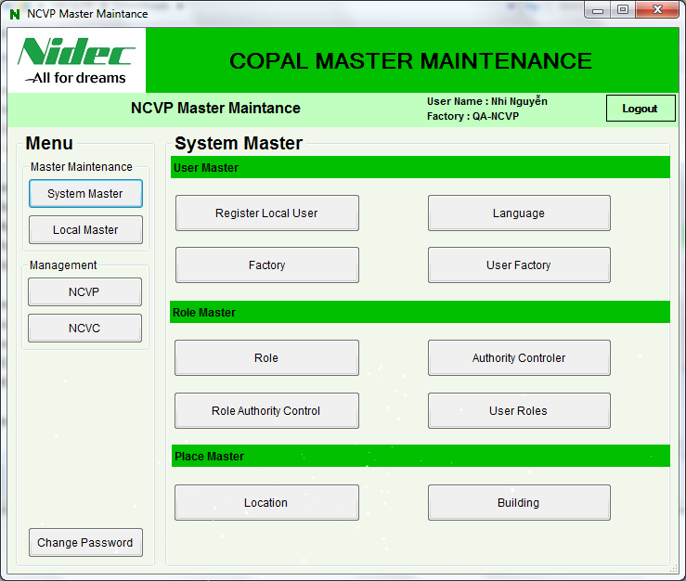
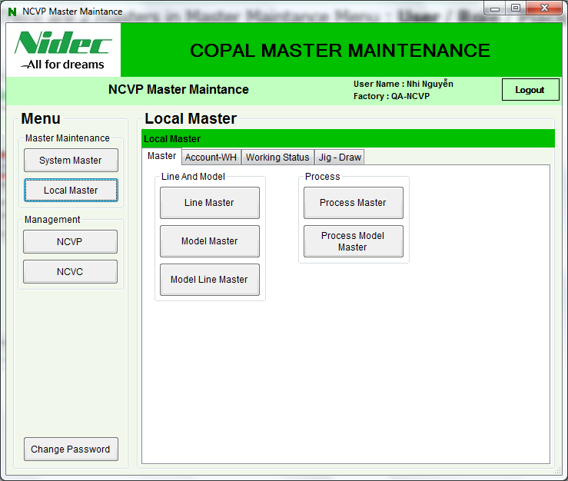
Ⅰ. Master Maintenance Menu
Setting basic information and user, that is divided into two parts:
1.System Master: Basic data set from NIDEC-MES
2.Facility Master: Globalization Data settings related to user and privilege
the basic data used in the system settings

Slide 6
Ⅰ.1 System Masters Relation
・System Master: Basic data set from NIDEC-MES
・System tab can be divided into 3 parts: User part / Role part / Place Part
When registering the master data, please follow the order shown in below picture.
2
1
1
3
1
1
2
3
2
1
- User has the field of country and language
- User-Factory defines the relation of User and Factory
- Role-Authority-Control defines the relation of Role and Authority
- User-Role defines the relation of User and Role
- Location has the field of Building

Slide 7
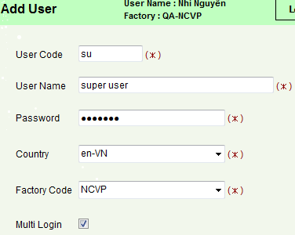
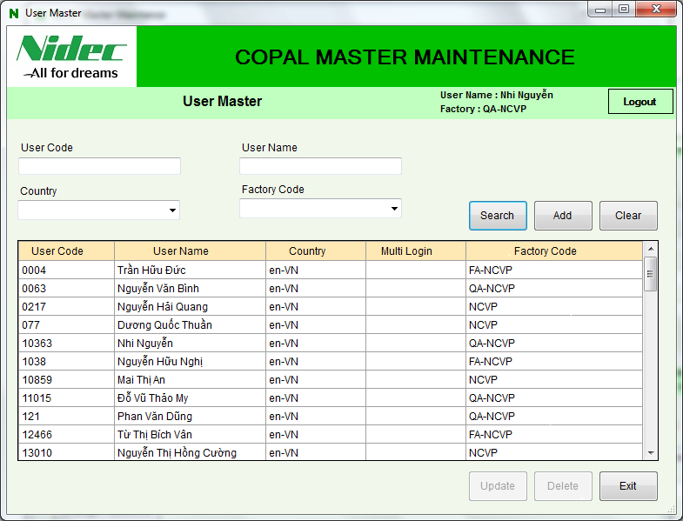
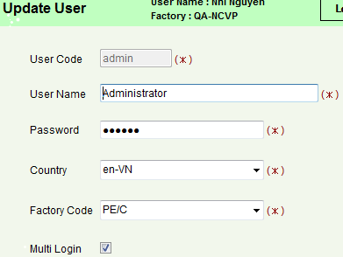
Ⅰ.1.1 Basic data
Basic data of system: User, Factory, Country Language

Slide 8
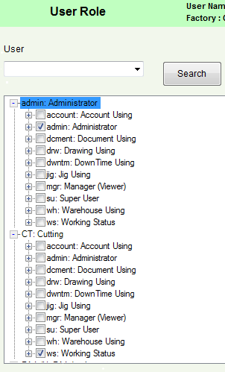
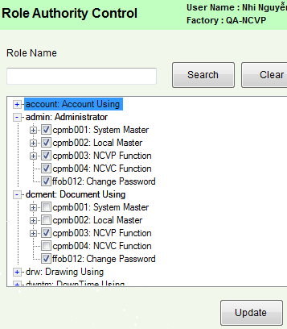
Ⅰ.1.2 Authority and Role User relation
Role has Authority(right to use specific menus) as its sub-component.
User has Role as its sub-component.
User
Role
Role
Authority

Slide 9
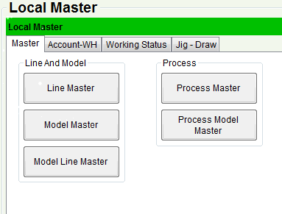
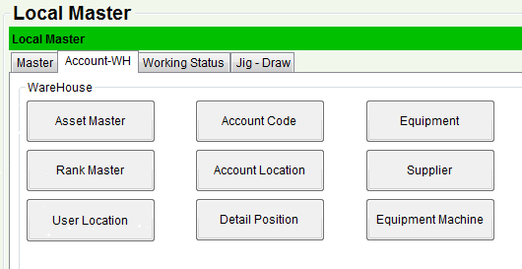
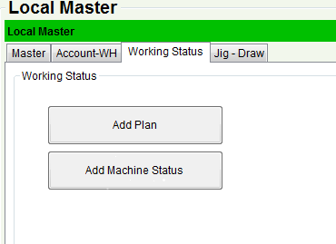
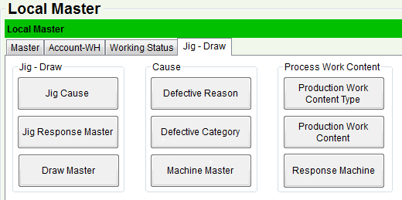
Ⅰ.2 Local Masters
Local masters can be divided into 4 tabs: Master / Account-WH / Working Status / Jig - Draw
When registering the master data, please follow the order shown in below picture.
Model Line defines the relation of Line and Model, Process Model defines the relation of Process and Model.
Account-WH, Working Status tabs have the item fields.
Response Machine has the item field, Production Work Content and Production Work Content Type defines the relation with each other.

Slide 10
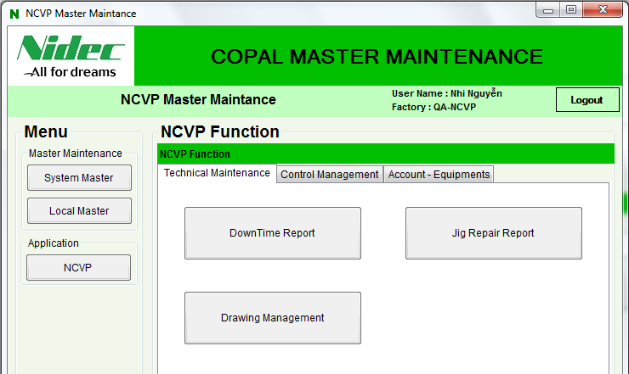
Ⅱ. NPMS Application Menu Overview
There are 3 tabs in NPMS application menu:
Technical Maintenance / Control Management / Warehouse - Equipment

Slide 11
Ⅱ.1.1 Drawing Management
Drawing Naming Rule is created like below information at NCVP and NCVC
【Drawing code】
1
Factory
Department
Model
Drawing Number
[NCVC]
NCVC 2 FA D – LS – 1473
2
1
2
3
4
3
[NCVP]
NCVP2FAD ＋ PM-MA-○○
4
1
2
3
4

Slide 12







Ⅱ.1.1 Drawing Management
【Management Folder】
NCVP2FAD PM-MA-○○-○1
parent folder
Auto cad
NCVP2FAD PM-MA-○○-○2
NCVP2FAD PM-MA-○○-○1
①Drawing
PDF
NCVP2FAD PM-MA-○○
Drawing Code
NCVP2FAD PM-MA-○○-○2
②List
NCVP2FAD PM-MA-○○List.xls
Only authorized people can create folders
⑤ Reversion data
③calculation
NCVP2FAD PM-MA-○○calculation.xls
Include ①②
④Improvement・failure
NCVP2FAD PM-MA-○○Kaizen.xls

Slide 13
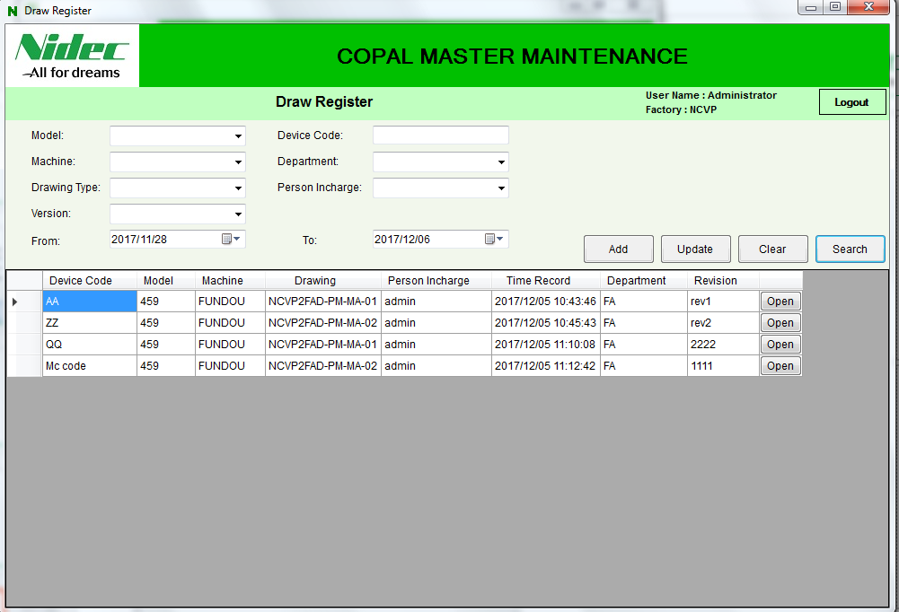
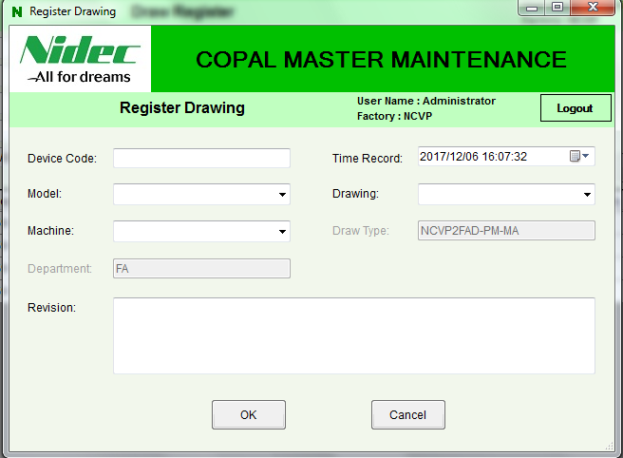
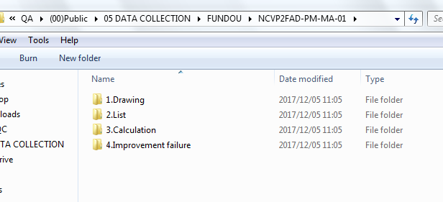
Ⅱ.1.1 Drawing Management
Draw Register Function:
You can search by each combo box in the interface (model, machine, drawing type, version, device code, department, person in charge and time)
Input the information in Register Drawing form then click OK, the data will be recorded in database and the save folder will be created follow Drawing Save Folder standard.
Click into Open button in datagridview to open drawing folder location and save the pdf file, auto cad file, ……..

Slide 14
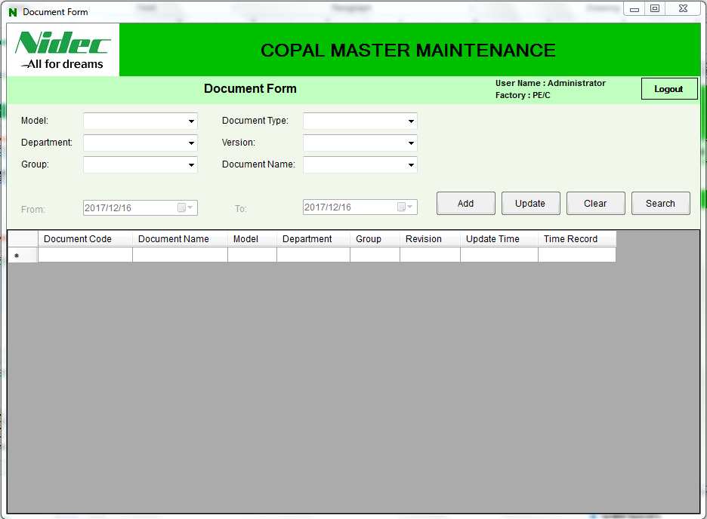
Ⅱ.1.2 Document Management
【Document code】
1
Department
[NCVP]
QA-○○○○○-○○○-○○○○-○○- ○○
2
Group
3
Document Type
1
2
3
4
5
6
4
Model (4 – 6 characters)
Ex:
QA-DTPQM-INS-KK03-01-01
5
Document Number
6
Revision Number
【 Search properties 】
Document code
Model
Document Type
Department
Group
Version
Document Name

Slide 15
Ⅱ.1.2 Document Management
【Document name】
Document name is written in English
The number of characters is under 60 characters
With each document, the first character like that:
+ SOP: SOP……………… (SOP)(*)
+ Standard: Standard ……… (STD)(*)
+ Inspect: Inspect………… (INS)(*)
+ Form: Form…………… (FRM)(*)
+ Data: Data…………… (DTA)(*)
+ Drawing: Drawing……… (DRW)(*)
+ Report: Report………… (RPT)(*)
+ Traceability: Traceability…… (TRC)(*)
(*) Document Type

Slide 16
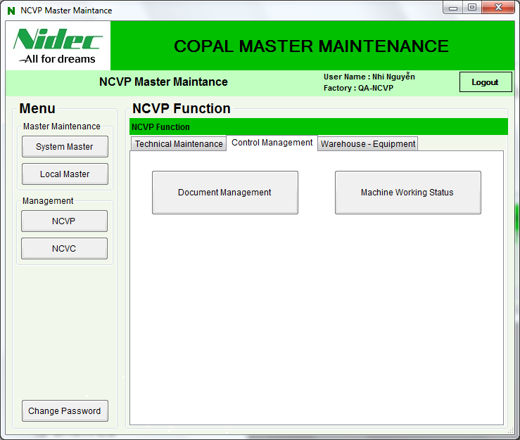
Ⅱ.1.2 Document Management
Login by your account and click on “NCVP” button → click on “Document Management” button
Function’s MainForm
is showed

Slide 17
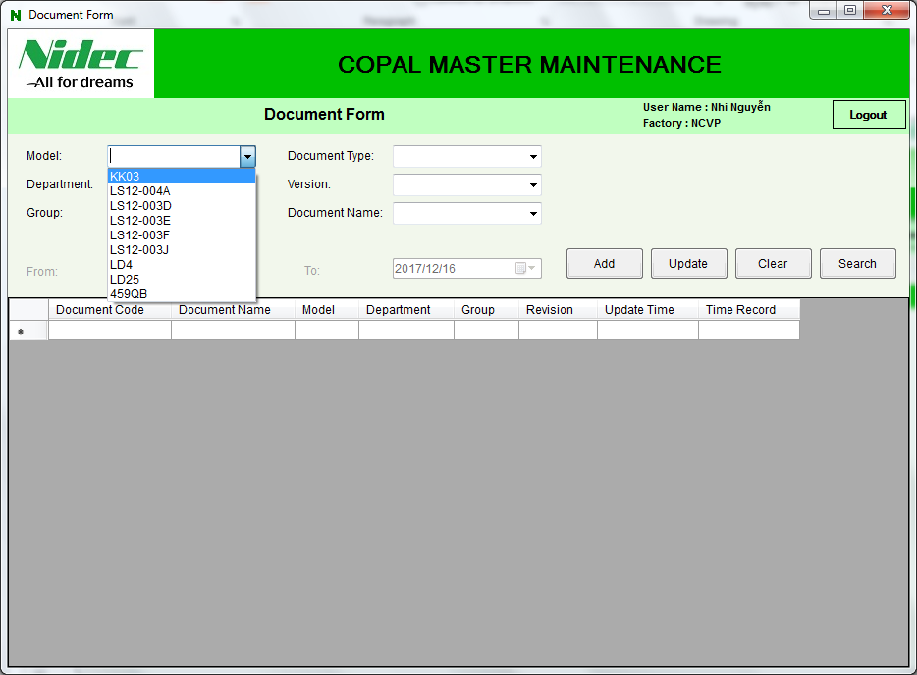
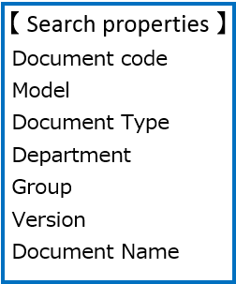
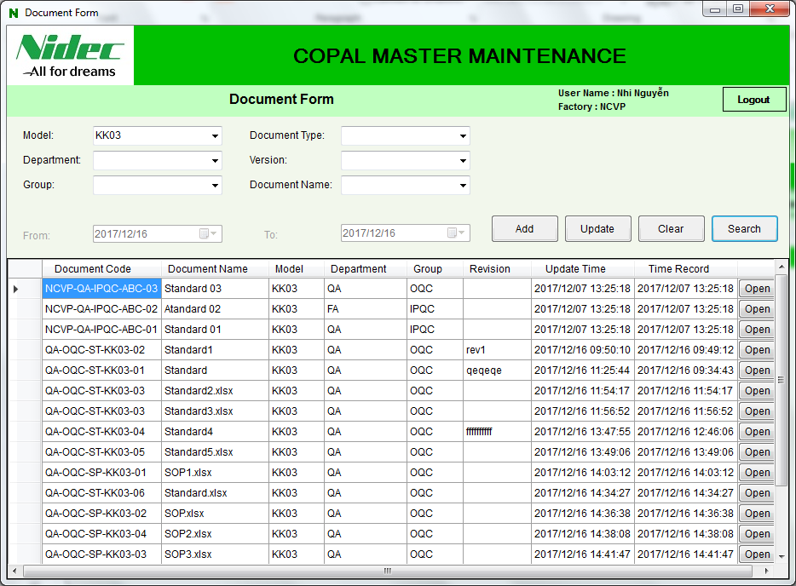
Ⅱ.1.2 Document Management
Select model before searching information
You can search by properties in slide 2
Click “Search” button to show the information
Click “Open” button on the row you want to view the document

Slide 18
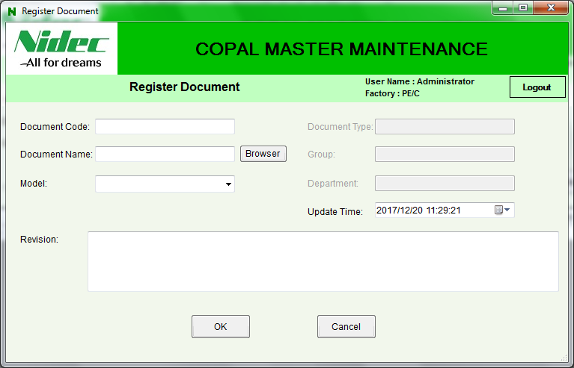
Ⅱ.1.2 Document Management
Click “Add” button to register new document
Click “Browser” button to chose the document file you want to save

Slide 19
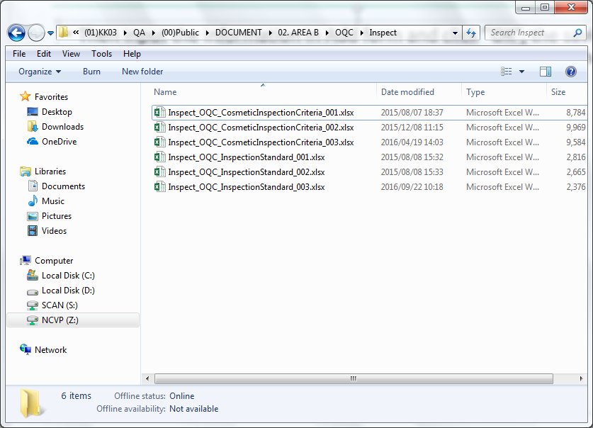
Ⅱ.1.2 Document Management
Then input the information in Add form and click “OK”, the saving folder will be showed and the document file will be auto saved in that

Slide 20
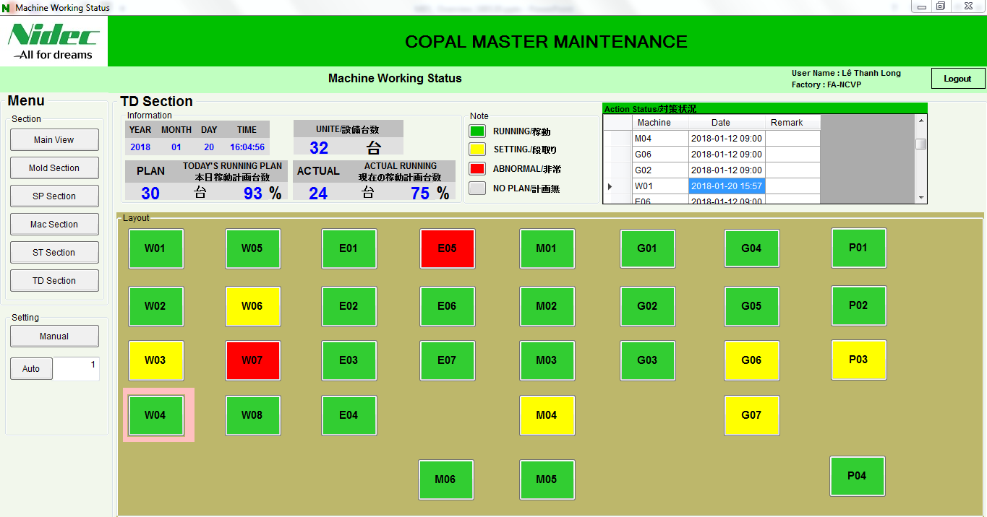
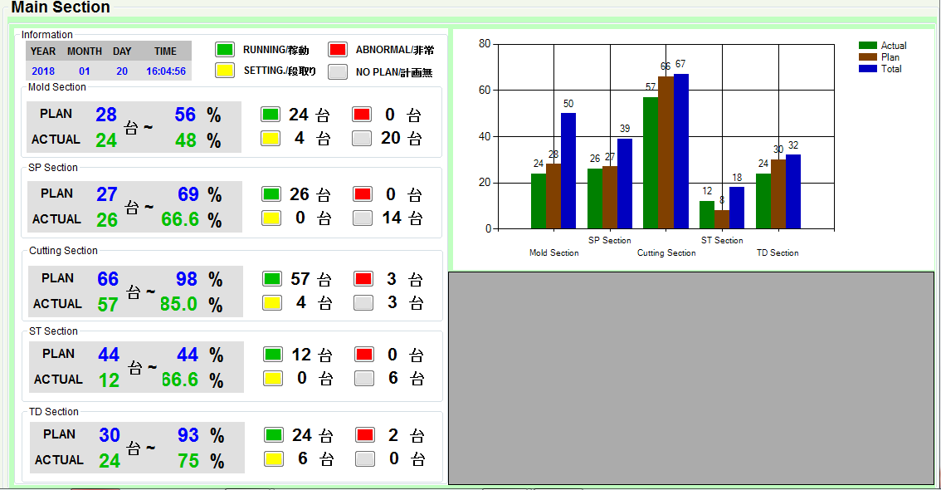
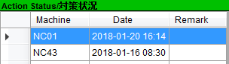
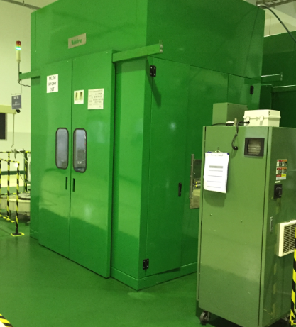
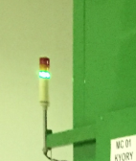
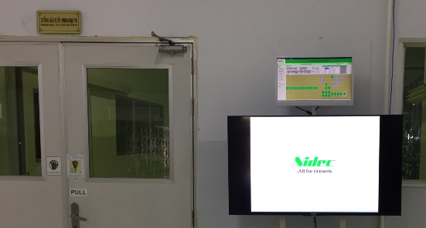
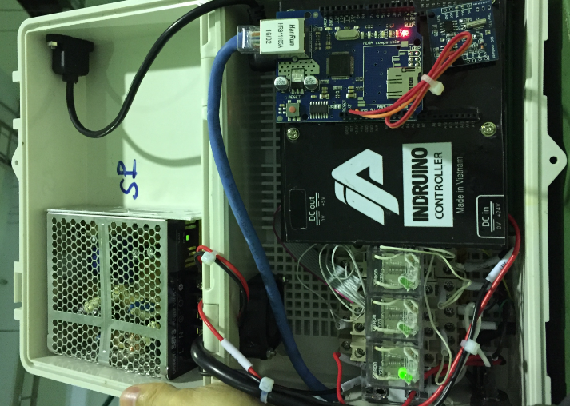
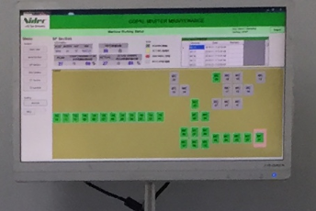
Ⅱ.2.1 Working machine status
It applied in 5 section in NCVP (ST, TD, SP, Cutting, Mold section with 250 machines).
Function: Showing auto working machine status and comments. (Timer >21 second)
Showing light machine status in software. Connecting by hardware (FM 2.4G)

Slide 21
Ⅱ.2.2 Equipment Management
Equipment Management using for follow all equipment in the company about their position, price, life cycle and depreciation.
The information will be linked with each section and accounting can show and follow the data without asking everyone like the way before.
Depreciation will be calculate for each section and send the information to account department by NidecMES

Slide 22
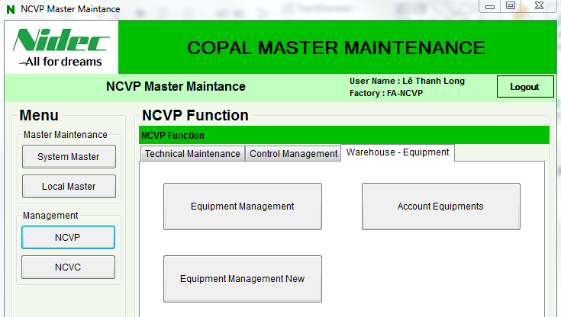
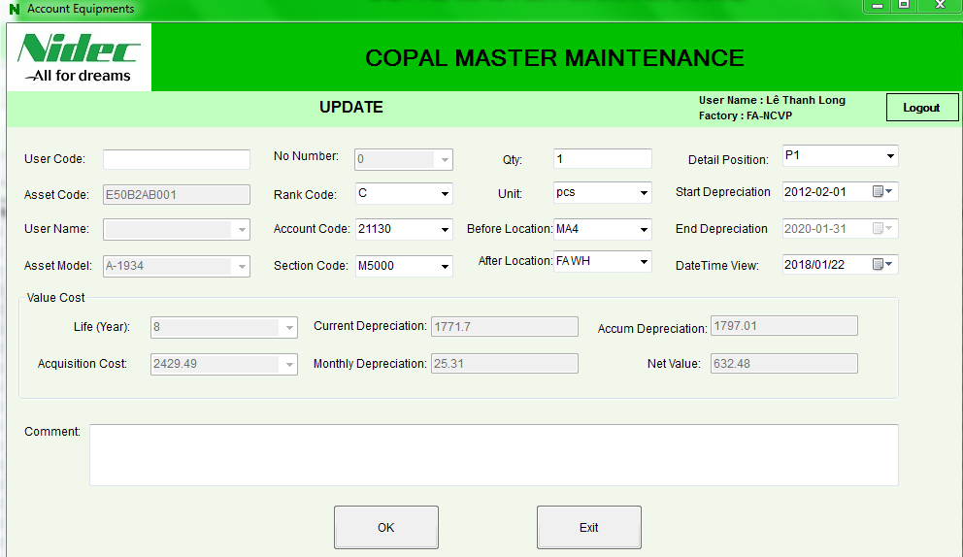
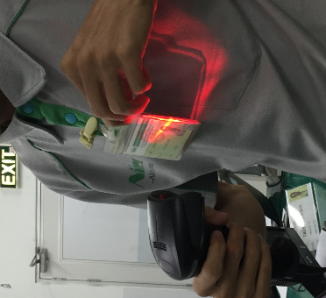
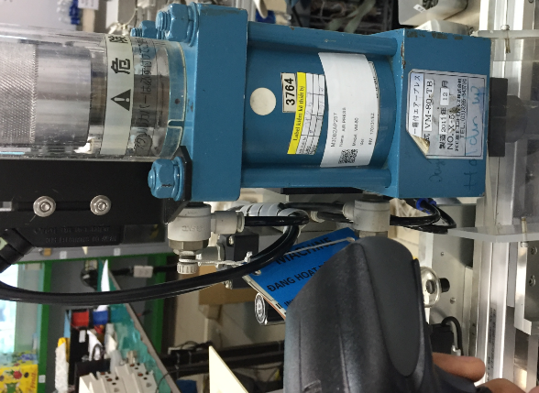
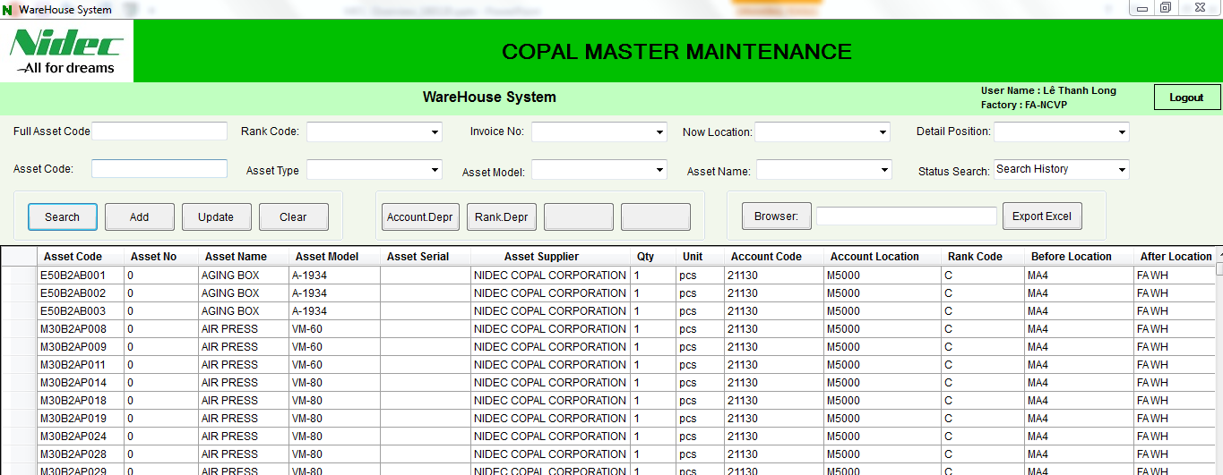
Ⅱ.2.2 Equipment Management
Equipment Management:
Function:
Equipment cost management (add, update, cost, and account report form
Check in- out person using.
Using: warehouse, section, account room.

Slide 23
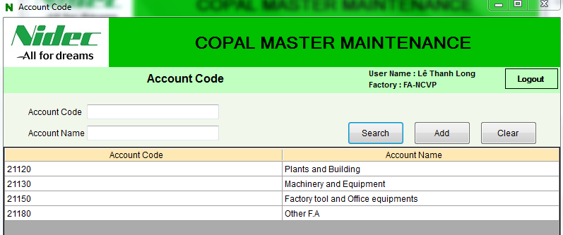
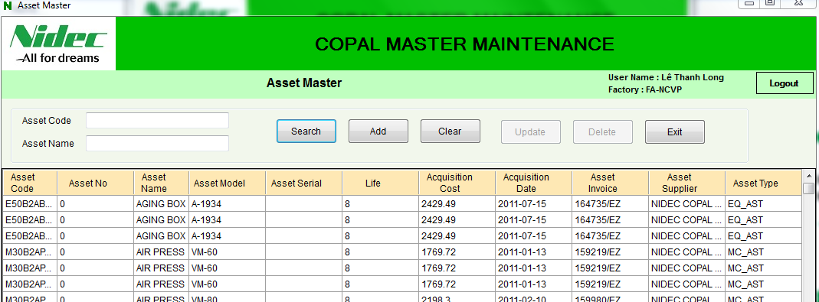
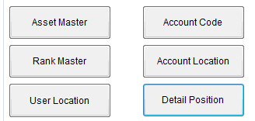
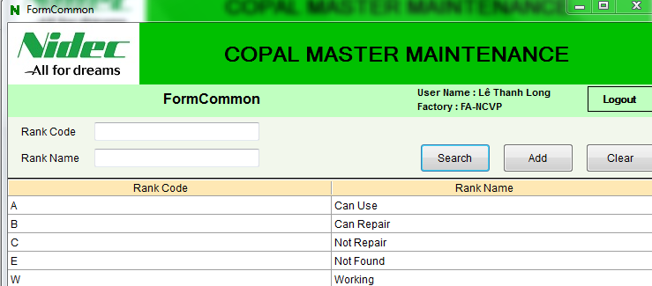
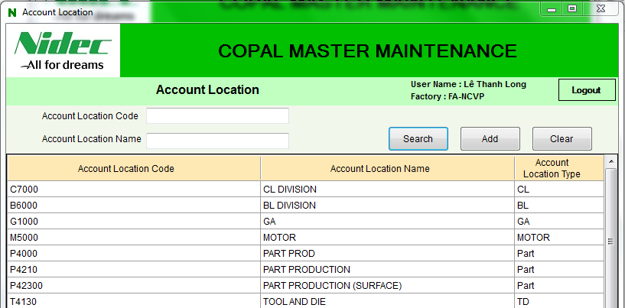
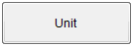
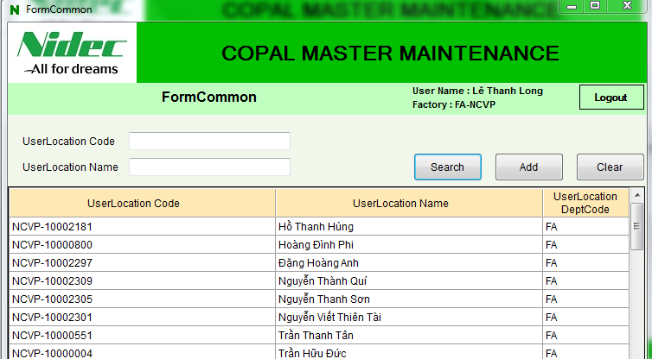


Ⅱ.2.2 Equipment Management
Local Master:
All equipment information: Rank, Barcode, Acquisition Cost, Account Code,
Detail location, Dept location…
Barcode, cost, date input..
Account code: Office, Machine..
Status: can use, working, NG..
Dept. selection….
User ID
Shelt, pallet no….

Slide 24



Ⅱ.2.2 Equipment Management
Barcode ruler
Barcode example

Slide 25


Ⅱ.2.2 Equipment Management
Click 'Add' to open form Add Equipment
Input items: User Code, Asset Code, User Name, No, Rank Code, Account Code, Section Code, Qty, Unit, Location, Start Depreciation, end Depreciation, Comment then click "OK'
Click
Click

Slide 26

Ⅱ.2.2 Equipment Management
Input value in items: Asset Code, Rank Code, Asset Type, Account Code, Section Code, Invoice No, Asset Model, Location, Asset Name then click Search
Click
When the equipment’s location is updated in each department by the person in charge, the equipment’s location will be updated in the account list and they can view and manage them without finding one by one.

Slide 27


Ⅱ.2.2 Equipment Management
Click Account Depr or Rank Depr to show items: Acquisition Cost, Current Depreciation, Month Depreciation, Net Book by Account Name
Click
Click

Slide 28


Ⅱ.2.3 Production Controller
The Production Controller support the user check and export production data safely and security. Follow the qty INPUT, OUTPUT and NG in line production. It is also support search and drawing the follow chart standard condition
2
1
3
The interface of Production Controller

Slide 29


Ⅱ.2.3 Production Controller
Double click on column process in table info to view detail. Ex: double click on column 'RA' in a row with time is 2018/04/09 detail data of process RA in 2018/04/09 will be show like bellow
Table info
Double click
The detail information is showed in the below table
Table info detail data of process

Slide 30




Ⅱ.2.3 Production Controller
Search data by Date then click 'Chart' to show the follow chart. Select type of chart and view
Click 'Chart'
Choose data

Slide 31


Ⅱ.2.3 Production Controller
Time Chart: Search data by Time then click 'Chart' to show the follow chart. Select type of chart and view
Click 'Chart'
Line Chart

Slide 32


Ⅱ.2.3 Production Controller
Pie chart by all process: This chart will show the NG qty data of all process base on Input qty data
Double click

Slide 33



Ⅱ.2.3 Production Controller
Pie chart by detail process: This chart will show the NG qty data for each process
Double click
Click Chart

Slide 34


Ⅱ.2.3 Production Controller
Control person in line: This function will control the numbers of operation in line production about absent, present, target,…..

